Slide 1
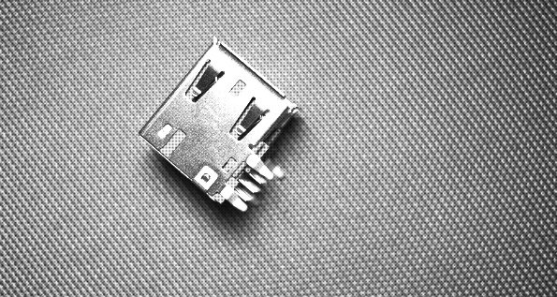
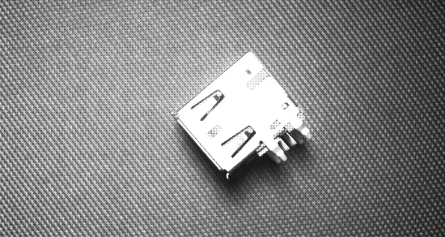
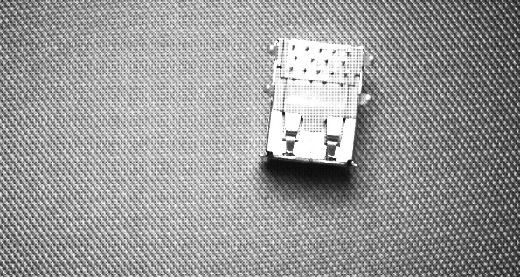
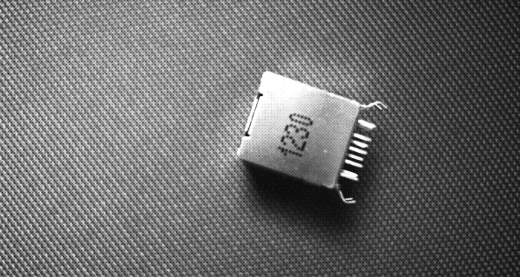
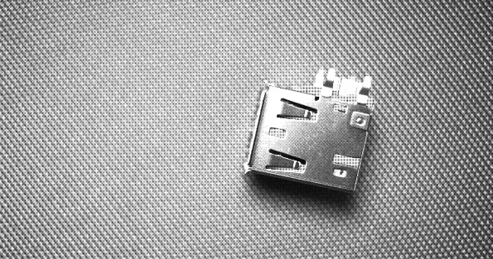
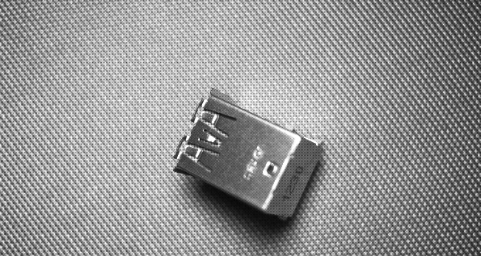
Input Pose
Target Pose
?

Slide 2
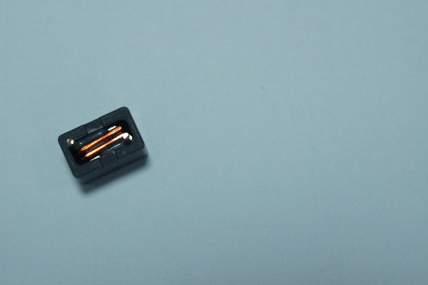
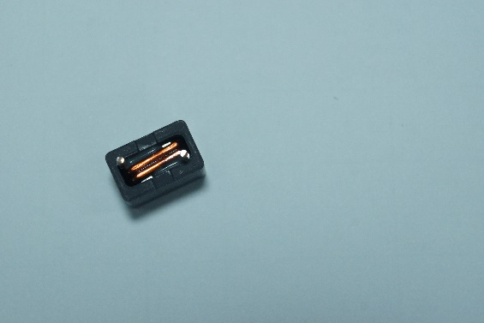
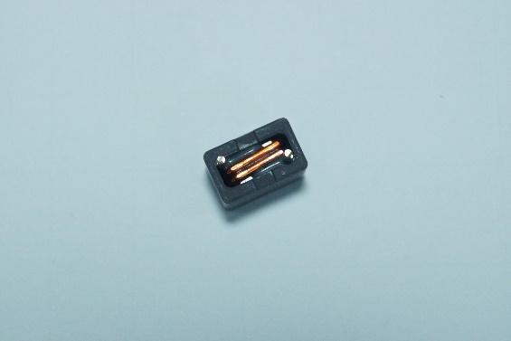
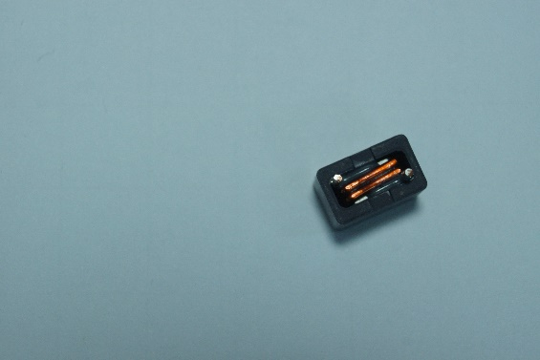
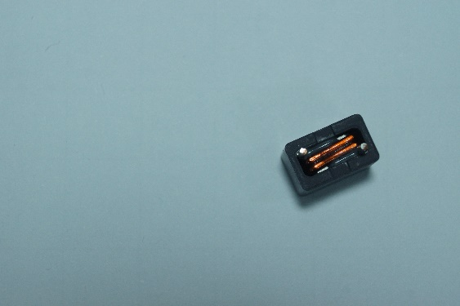
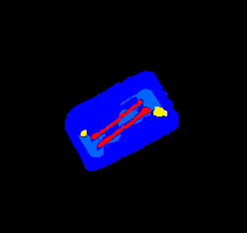
1
2
Background 0
4
3

Slide 3
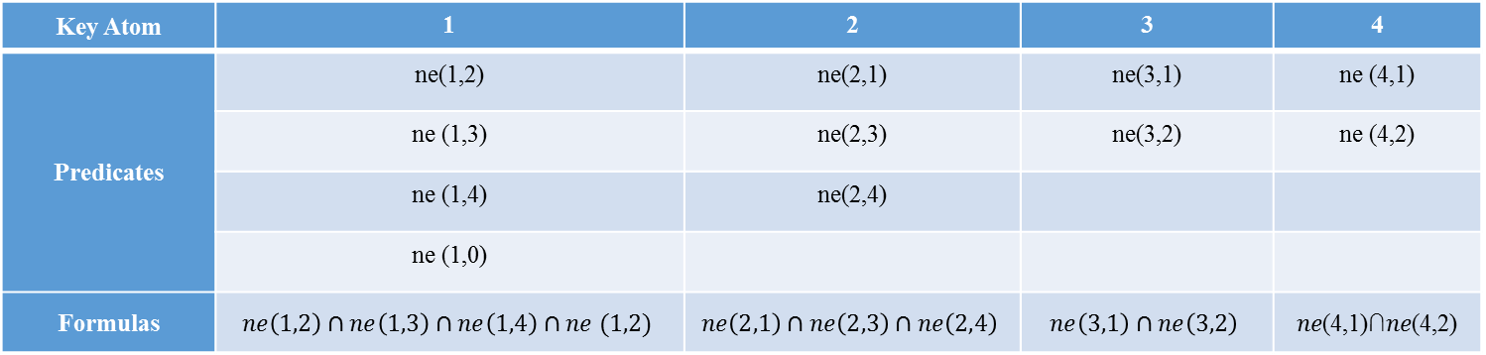
Key Atom | 1 | 2 | 3 | 4
Predicates | ne(1,2) | ne(2,1) | ne(3,1) | ne (4,1)
 | ne (1,3) | ne(2,3) | ne(3,2) | ne (4,2)
 | ne (1,4) | ne(2,4)
 | ne (1,0)
Formulas | $$ne\left(1,2\right)∩ne\left(1,3\right)∩ne\left(1,4\right)∩ne (1,2)$$ | $$ne\left(2,1\right)∩ne\left(2,3\right)∩ne\left(2,4\right)$$ | $$ne\left(3,1\right)∩ne\left(3,2\right)$$ | 𝑛𝑒(4,1)∩𝑛𝑒(4,2)

Slide 4
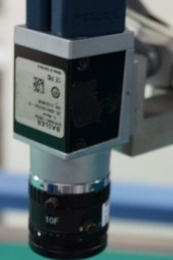
Repository
Learning Method
Camera 2
Camera 1
Multilayers Networks
Input
Matching
Robot Arm
Measurement

Slide 5
Input
Camera 1
Camera 2
Capture Image
θ^{U}
d^{in}
Matching
θ^{C}
Validation
Preprocessing
Robot Arm
{O^{U}}
{O^{C}}
False
True
Hierarchical Model
Learning

Slide 6



實施方式
輸入
攝影機 1
攝影機 2
擷取影像
匹配
驗證
預處理
機械手臂
資料庫
學習系統

Slide 7
0 | 0 | 0
0 | 4 | 1
0 | 2 | 1
4 | 1 | 2
2 | 1 | 2
1 | 1 | 3
1 | 2 | 0
1 | 3 | 0
0 | 0 | 0
0 | 0 | 0 | 0 | 0
0 | 4 | 1 | 2 | 0
0 | 2 | 1 | 2 | 0
0 | 1 | 1 | 3 | 0
0 | 0 | 0 | 0 | 0
4 | 1 | 2
2 | 1 | 2
1 | 1 | 3
0 | 4 | 1
0 | 2 | 1
0 | 1 | 1
1 | 2 | 0
1 | 2 | 0
1 | 3 | 0
0 | 0 | 0
1 | 2 | 0
1 | 2 | 0
0 | 2 | 1
0 | 1 | 1
0 | 0 | 0
2 | 1 | 2
1 | 1 | 3
0 | 0 | 0
0 | 0 | 0
4 | 1 | 2
2 | 1 | 2

Slide 8
Ground Network
Irrelevant Atoms
Evidence
Descriptor(D)
Descriptor(C)
Descriptor(A)
Model(obj_B)
Model(obj_A)
Descriptor(E)
Query
Descriptor(B)

Slide 9
Image 1
Neighbor(1,0)
Neighbor_sub(1,2)
Neighbor(2,1)
Evidence
Neighbor(1,2)
Descriptor(A)
Neighbor(2,0)
Evidence
Model(obj_A)
Query
Evidence
Neighbor(3,2)
Descriptor(B)
Neighbor(2,0)
Neighbor(3,0)
Neighbor_sub(2,3)
Neighbor(2,3)
Descriptor B:Descriptor of a work piece “obj_A” with different pose

Slide 10
$$Γ_{kn}$$
Neighbor(1,0)
Neighbor_sub(1,2)
Neighbor(2,1)
Evidence
Neighbor(1,2)
Descriptor(A)
Neighbor(2,0)
Evidence
Model(obj_A)
Query
Evidence
Neighbor(3,2)
Descriptor(B)
Neighbor(2,0)
Neighbor(3,0)
Neighbor_sub(2,3)
Neighbor(2,3)
Descriptor B:Descriptor of a work piece “obj_A” with different pose

Slide 11
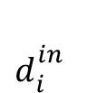
Query
f₇
f₁
$$d_{i}^{in}$$
f₃
Common
Feature
f₂
Markov Blaket
Evidence
f₂
f₂
f₈
f₆
d_{2n}
d₁₁
f_{J}
f₅
f₄
O₂
O₁
d₂₁
d_{2N}
d_{1M}
d₁₂

Slide 12
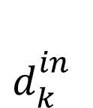
d₁₁
d₂₁
d_{N1}
d₁₁
d₂₁
d_{N1}
…….
…..
……….
Evidence
d_{NW}
d_{1M}
d_{2V}
…….
f₁
f₂
f₃
f₄
Features
f₅
f₆
f₇
…….
f_{J}
$$d_{k}^{in}$$
Query

Slide 13

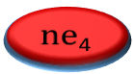
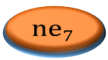
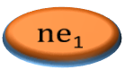


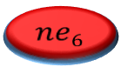
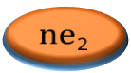




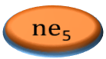

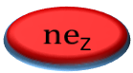

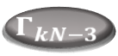
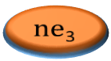
$Γ_{k}$₁
$Γ_{k}$₂
$$Γ_{k3}$$
$Γ_{k}$₄
$Γ_{k}$_{g}
…….
$$Γ_{k}$$
…….
$$Γ_{kN−3}$$
$$Γ_{kN−2}$$
$$Γ_{kN−1}$$
$$Γ_{kN}$$
$$\text{ne}\text{1}$$
$$\text{n}\text{e}\text{2}$$
$$\text{n}\text{e}\text{3}$$
$$\text{n}\text{e}\text{4}$$
Predicates
$$\text{n}\text{e}\text{5}$$
$$ne6$$
$$\text{ne}7$$
…….
$\text{n}\text{e}$_{Z}

Slide 14

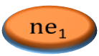
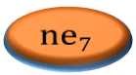


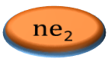
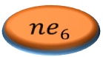

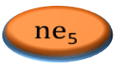

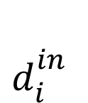
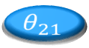
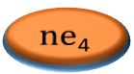
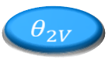
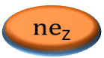


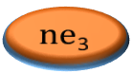
Objects
O₁
……….
O₂
O_{N}
$$θ_{11}$$
$$θ_{21}$$
$$θ_{N1}$$
$$θ_{12}$$
$$θ_{22}$$
$$θ_{N2}$$
Rotation
angle
…….
…..
…..
$$θ_{1M}$$
$$θ_{2V}$$
……….
$$θ_{NW}$$
d₁₁
d₂₁
d_{N1}
d₁₁
d₂₁
d_{N1}
…….
…..
……….
Descriptors
d_{1M}
d_{2V}
…….
d_{NW}
$$\text{ne}\text{1}$$
$$\text{n}\text{e}\text{2}$$
$$\text{n}\text{e}\text{3}$$
$$\text{n}\text{e}\text{4}$$
Features
$$\text{n}\text{e}\text{5}$$
$$ne6$$
$$\text{ne}7$$
$\text{n}\text{e}$_{Z}
…….
$$d_{i}^{in}$$
Query

Slide 15
O₁
O₂
……
O_{N}
Object
……
θ₁
θ₂
θ_{M}
Rotation angle
d₁
d₂
……
d_{W}
Descriptor
Feature
Γ₁
Γ₂
……
Γ_{K}
Query
d^{in}

Slide 16
O^{C}₁
O^{C}₂
……
O^{C}_{N}
Object(O^{C})
Rotation angle
(Ө^{C})
……
……
Inferred
rotation angle
(Ө^{U})
θ^{C}₁
θ^{C}₂
θ^{C}_{M}
θ^{U}₁
θ₂
θ^{U}_{I}
d^{C}₂
……
d^{U}₁
……
d^{C}₁
d^{C}_{W}
d^{U}₂
d^{U}_{R}
Unclassified Descriptor
(D^{U})
Classified Descriptor
(D^{C})
Feature(Γ)
Γ₁
Γ₂
……
Γ_{K}
Query
d^{in}

Slide 17
O^{C}
RBM
RBM
Ө^{C}
Ө^{U}
RBM
RBM
D^{C}
D^{U}
MLN
MLN
Γ_{K}

Slide 18
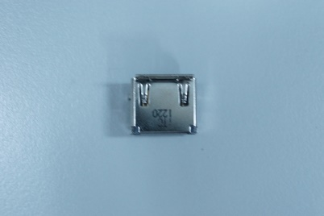
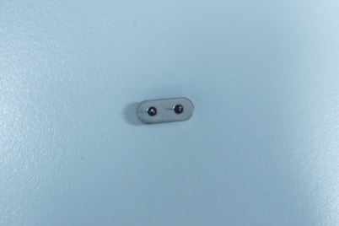
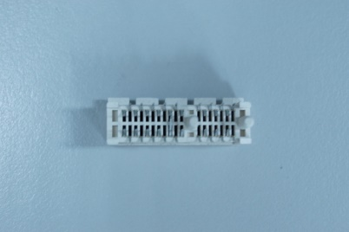
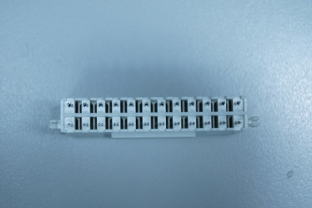
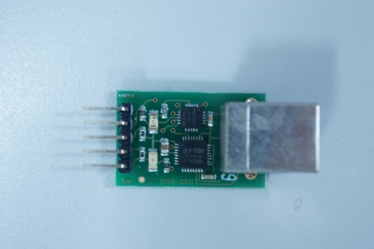
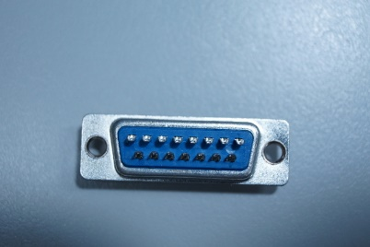
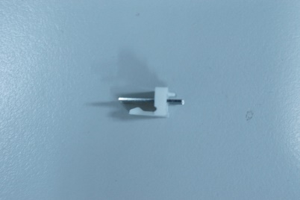
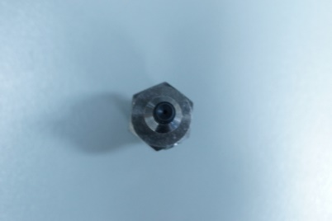
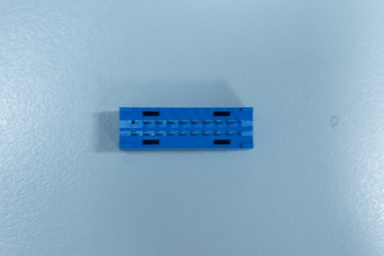
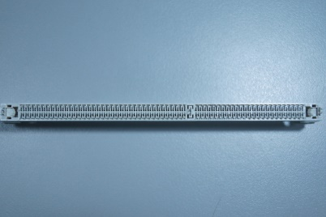
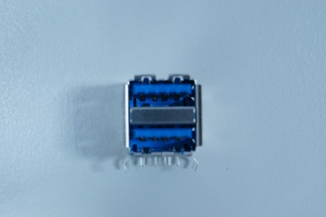
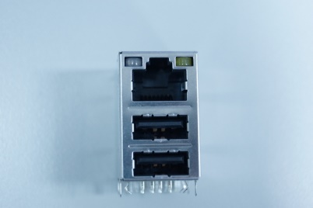
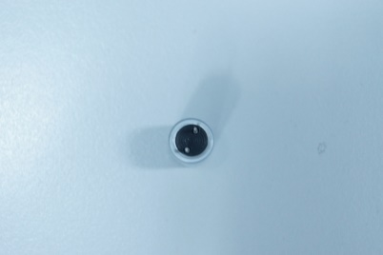
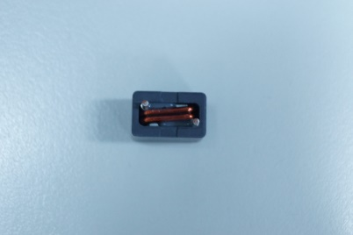






WP1 |  | WP2 |  | WP3
WP1.1 | WP1.5 | WP2.1 | WP2.5 | WP3.1 | WP3.5
WP1.2 | WP1.6 | WP2.2 | WP2.6 | WP3.2 | WP3.6
WP1.3 | WP1.7 | WP2.3 |  | WP3.3 | WP3.7
WP1.4 |  | WP2.4 |  | WP3.4

Slide 19


Slide 20


Slide 21


Slide 22


Slide 23


Slide 24


